Slide 1

ENHANCING VISUAL UNDERSTANDING THROUGH VERBAL IMAGE CAPTION GENERATOR USING ADVANCED DNN TECHNIQUES
Under the Supervision of
Mr. B. Avinash _{M. Tech(Ph. D);}
Assistant Professor
Presented By:
1.Tiruveedhula Amrutha Lakshmi 20BQ1A12G9
2.Rayala Meghana 20BQ1A12E2
3.Tummalapudi Sowmya 20BQ1A12H1
4.Koppula Bhavya Sree 21BQ5A1222
Department of Information Technology
Vasireddy Venkatadri Institute of Technology
Pedakakani Mandal, Nambur, Guntur-522508

Slide 2
Contents Outline
Abstract
Introduction and Literature Survey
Existing System with Architecture
Proposed System Architecture with Advantages
Objectives of Proposed System
System Requirements
a. Software Requirements
b. Hardware Requirements
7. Proposed System Design and Implementation
a. DataFlow Diagrams, UML Diagrams
b. Modules
8. Unit Testing and System Testing
9. Results
10. Conclusion
11. Future Enhancement
12. References

Slide 3
ABSTRACT
In recent years, image caption generators have made significant strides in utilizing Deep Learning techniques to automatically generate descriptive captions for images.
However, these systems are limited in their reliance on textual outputs, which can be challenging for users with visual impairments or in situations where reading is impractical.
To address this limitation, we propose an innovative extension to the existing image caption generator.
Our project integrates a verbal description mechanism to read out the generated captions, enhancing accessibility and user experience.
This concise integration empowers users to interact with visual content audibly, making the system more inclusive and user-friendly in various contexts.
This extension opens-up new possibilities for applications in assistive technologies, multimedia presentations, and content consumption.

Slide 4
INTRODUCTION
Image caption generation is a powerful technology at the intersection of computer vision and natural language processing.
The Image caption generator is a task that involves computer vision and NLP(natural language processing) Concepts to recognize the context of an image and describe them in a natural language like English.
In this Image caption generator, basis on our provided or uploaded image file, it will generate the caption from a trained model which is trained using algorithms and on a large dataset.
The main idea behind our project is that users will get automated captions when we use or implement it on social media or on any applications.
The ultimate purpose of Image caption generator is to make user’s experience better by generating automated captions.

Slide 5
LITERATURE SURVEY
S.NO | Author & Members | Concept | Methods Used | Advantages | Disadvantages
1 | M. Pranay Kumar, V. Snigdha, R. Nandini, Dr. B. Indira Reddy | Image caption generator using CNN and LSTM. | CNN for image features, LSTM for captions. | Wide applicability, combining computer vision and NLP. | Doesn't discuss implementation challenges or potential limitations.
2 | Julu Basnet, Supriya Kumari, Mohit Rathore, Dipanshu | Image captioning using CNN-LSTM for the visually impaired. | CNN-LSTM, Flickr-8k dataset. | Acknowledges benefits for accessibility, overfitting challenges. | Offers limited technical details about the implementation.
3 | Swarnim Tripathi, Ravi Sharma | Image captioning's importance for various applications. | General discussion, potential text-to-speech applications. | Recognizes image accessibility, real-time feedback potential. | Lacks specific technical details and in-depth analysis.
4 | Janvi Jambhale, Shreeya Sangale, Aarti Avhad, Payal Vairagade, Jameer Kotwal | Automatic image caption generation and its practicality. | Deep learning, BLEU metric, overfitting challenges. | Highlights accessibility and automation potential. | Doesn't provide extensive information about the model used.
5 | Parth Kotak, Prem Kotak | Progress in image captioning using CNNs and LSTMs. | CNNs, LSTMs, applications in news, medicine, and more. | Recognizes the value of image captioning for various fields. | Limited technical details about the implementation.

Slide 6
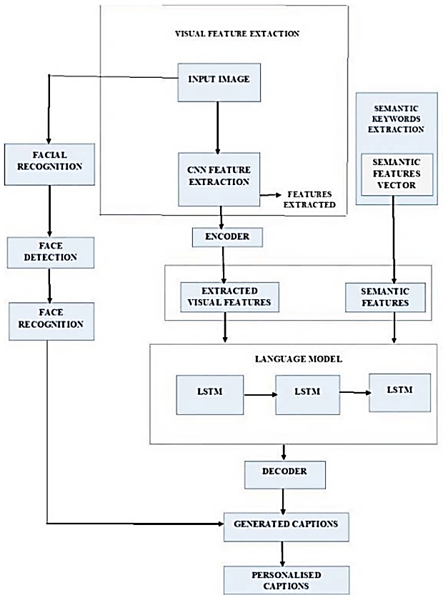
EXISTING SYSTEM WITH ARCHITECTURE
The existing system involves a software application or algorithm that takes an input image as its primary data source. This image is then processed using advanced computer vision techniques and deep learning models.
The model has been trained on a large dataset of images paired with corresponding captions to learn how to generate accurate and informative descriptions.
Figure 1: Existing System Architecture of Image Caption Generator

Slide 7
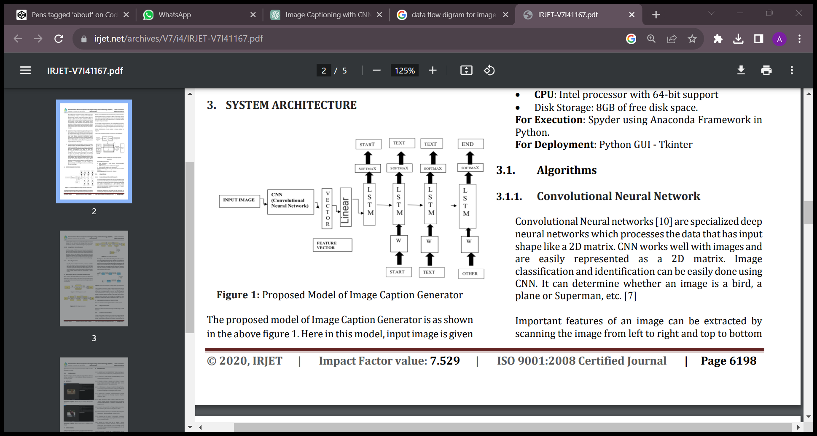
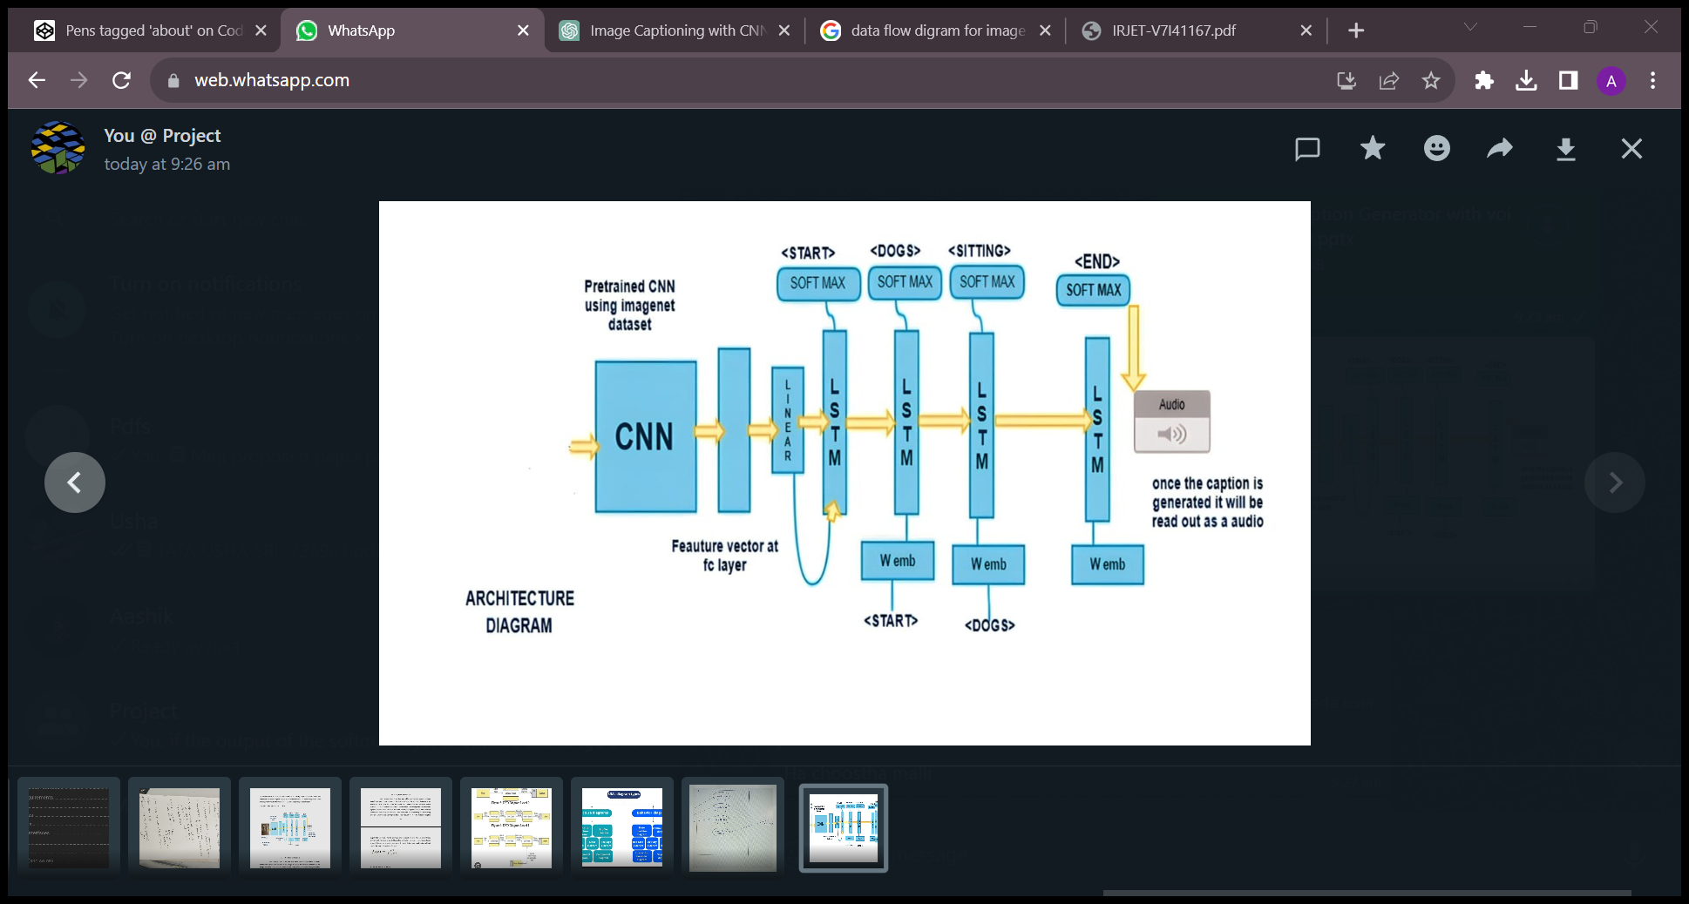
PROPOSED SYSTEM WITH ARCHITECTURE
The Proposed methodology consists of object detection, Convolution Neural Network (CNN) for feature extraction and for scene classification using deep learning with voice synthesis. So, to make our image caption generator model, we will be merging these architectures. It is also called a CNN-RNN model.
We will use the pre-trained model Exception. And LSTM will use the information from CNN to help generate a description of the image. Once the caption is generated, it will play it.
Figure 2: Proposed System Architecture of Image Caption Generator

Slide 8
OBJECTIVES OF PROPOSED SYSTEM
Image Understanding: The primary goal of the system is to understand the content of an image and extract meaningful information from it. The CNN part of the model is responsible for extracting visual features from the image, capturing details at different levels of abstraction.
Text Generation: The LSTM part of the model takes the extracted image features as input and generates coherent and contextually relevant textual descriptions for the given image. The objective is to create accurate and semantically meaningful captions.
Natural Language Generation: The text output should read fluently and coherently, ensuring that the generated captions are grammatically correct, contextually relevant, and fluent.
Voice Synthesis: To provide voice output, the generated textual captions need to be converted into natural-sounding speech. This involves integrating a Google Text-to-Speech (gTTS) system that can convert the generated captions into spoken language.

Slide 9
SYSTEM REQUIREMENTS
SOFTWARE REQUIREMENTS
Programming Languages : Python(for DL Algorithms,
NLP Processing, and UI development)
Libraries and Frameworks :
TensorFlow: For building and training CNN and LSTM.
gTTS (Google Text-to-Speech): A Python library and CLI tool to interface with Google Text-to-Speech API.
Integrated Development Environment(IDE) :
Anaconda Jupyter Notebook for coding and development.
HARDWARE REQUIREMENTS
Processor(CPU): A modern multi-core processor AMD Ryzen 5 5500U with Radeon Graphics with 2.10 GHz to handle the computational demands of machine learning and deep learning algorithms.
Memory(RAM): 8 GB of RAM is used to efficiently process and manipulate data.
Storage: To Handle the size of the dataset and models, we used 512GB SSD Storage.

Slide 10
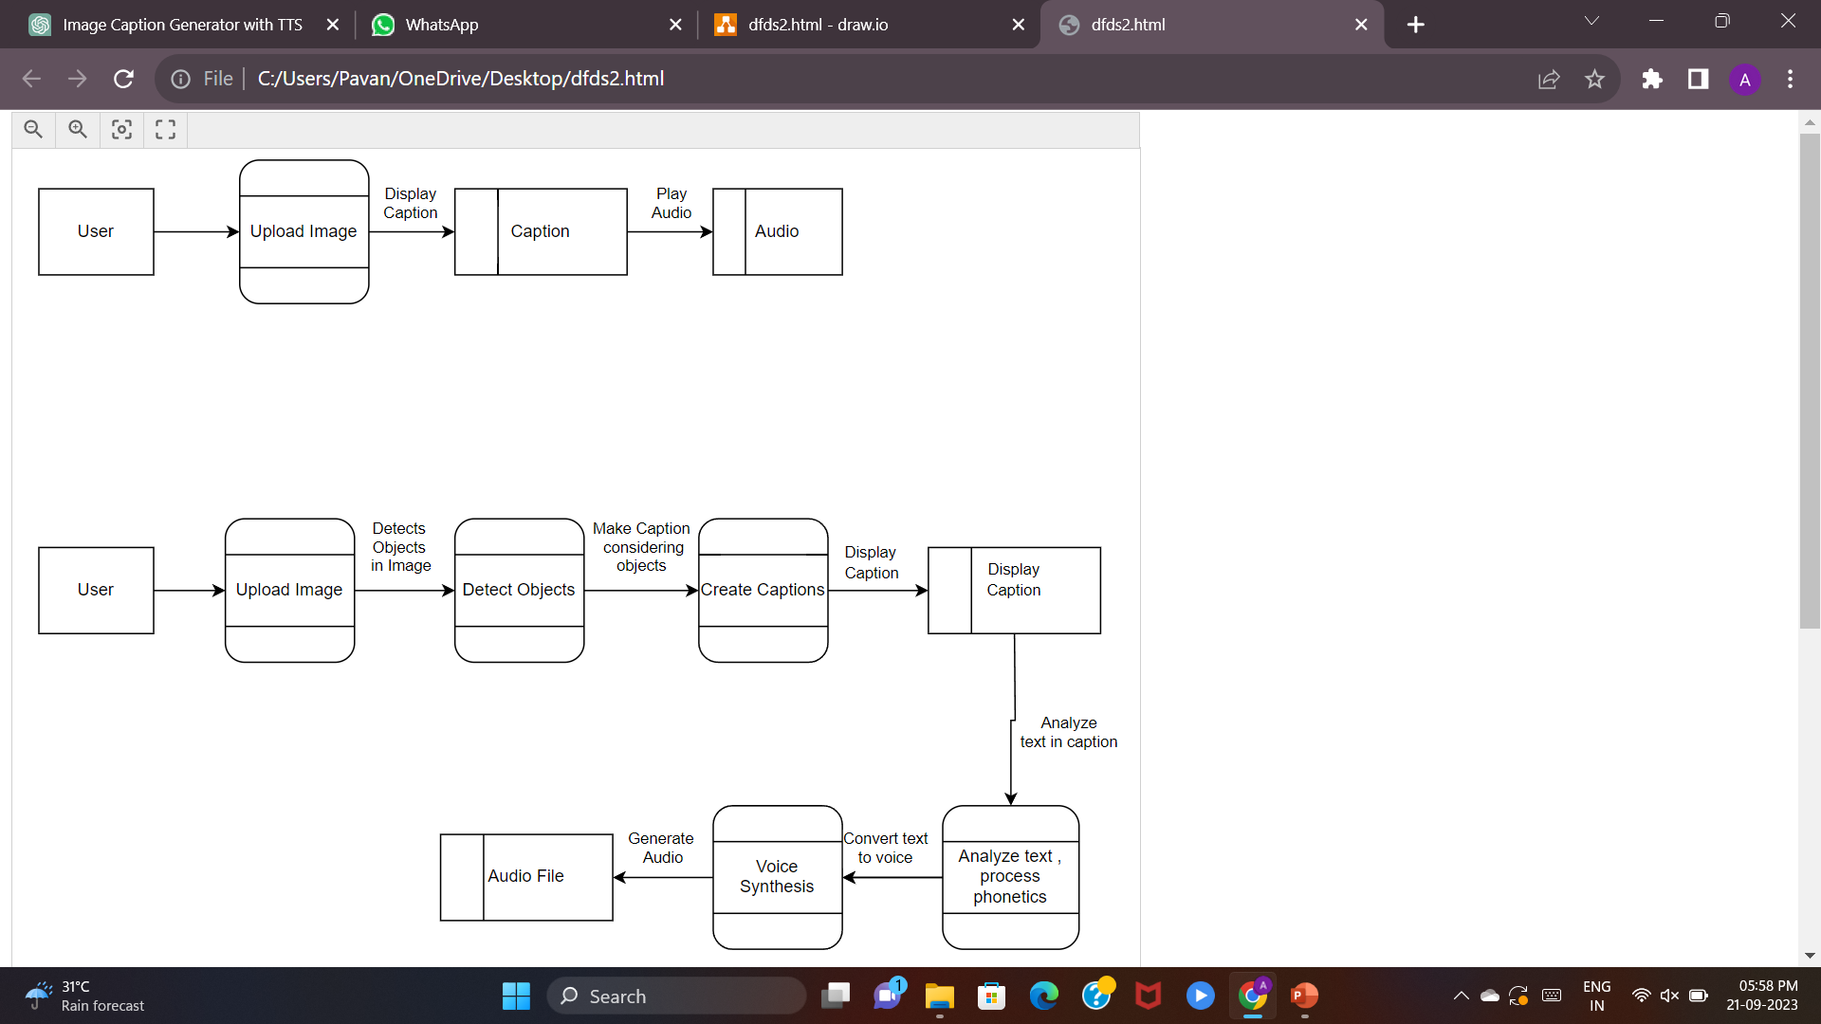
DATA FLOW DIAGRAMS
A Level 0 DFD provides a high-level overview of a system by illustrating how external entities interact with the system through processes, how data flows between them, and where data is stored.
Figure 3: DFD Diagram Level 0
A Level 1 Data Flow Diagram (DFD) offers detailed insights into the system's functionality by breaking down Level 0 DFD processes into sub-processes and providing additional data flow details. It serves to enhance the granularity and understanding of the system's data processing and interactions.
Figure 4: DFD Diagram Level 1

Slide 11
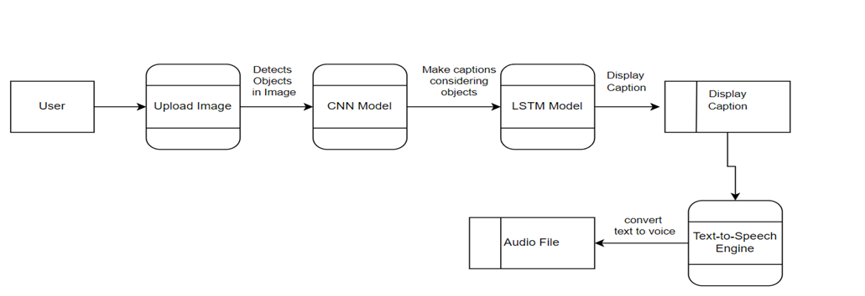
DATA FLOW DIAGRAMS
In a DFD Level 2 for the Image Caption Generator, it further details the system's processes. It includes "Uploads Image" as the initial user step, "CNN Model" for feature extraction, and "LSTM Model" for caption generation, enhancing understanding of the system's data flow and processing.
Figure 5: DFD Diagram Level 2

Slide 12
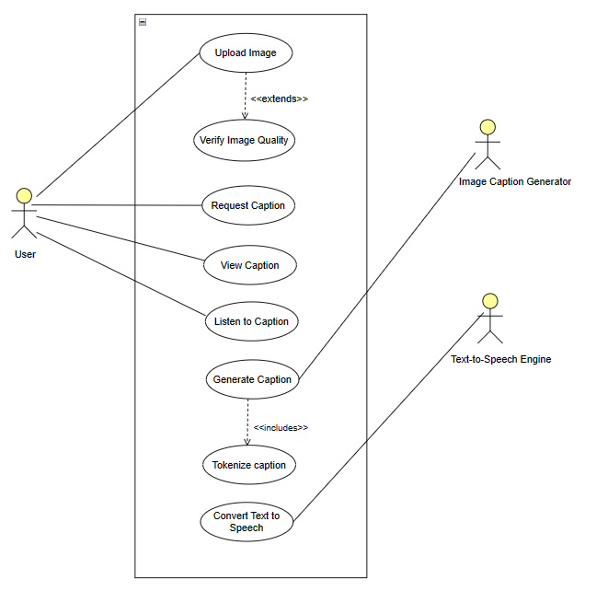
USE-CASE DIAGRAM OF IMAGE CAPTION GENERATOR
The Use-case diagram highlights actors "User" and "Text-to-Speech Engine" with 3 core use cases: "Upload Image," "Generate Caption," and "Read Caption Aloud." This provides a clear overview of system functionality and interactions, facilitating requirements analysis and communication.
Figure 6: Use-Case Diagram of Image Caption Generator

Slide 13
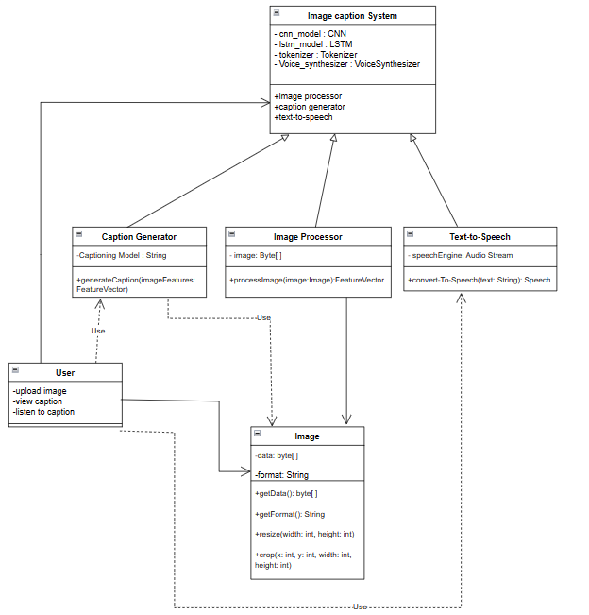
CLASS DIAGRAM OF IMAGE CAPTION GENERATOR
The Class diagram presents essential classes like "Image-Processor," "Caption-Generator," "Text-To-Speech," and "User," depicting their relationships for object-oriented design. It guides developers in creating a structured system for image captioning and auditory feedback, ensuring a cohesive architecture.
1
1
1
1
1
1
1
1
1
1
1
1
1
1
1
1
1
1
Figure 7: Class Diagram of Image Caption Generator
13

Slide 14
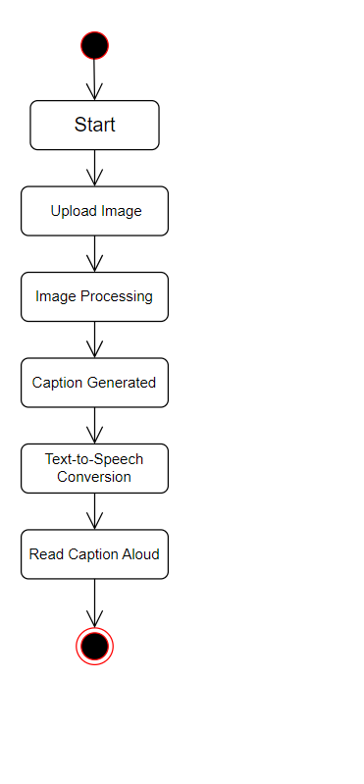
ACTIVITY DIAGRAM OF IMAGE CAPTION GENERATOR
The activity diagram illustrates the sequential system processes, starting with image upload, process the image then caption generation using CNN and LSTM. Finally, it portrays text-to-speech conversion for spoken caption.
Figure 8: Activity Diagram of Image Caption Generator

Slide 15
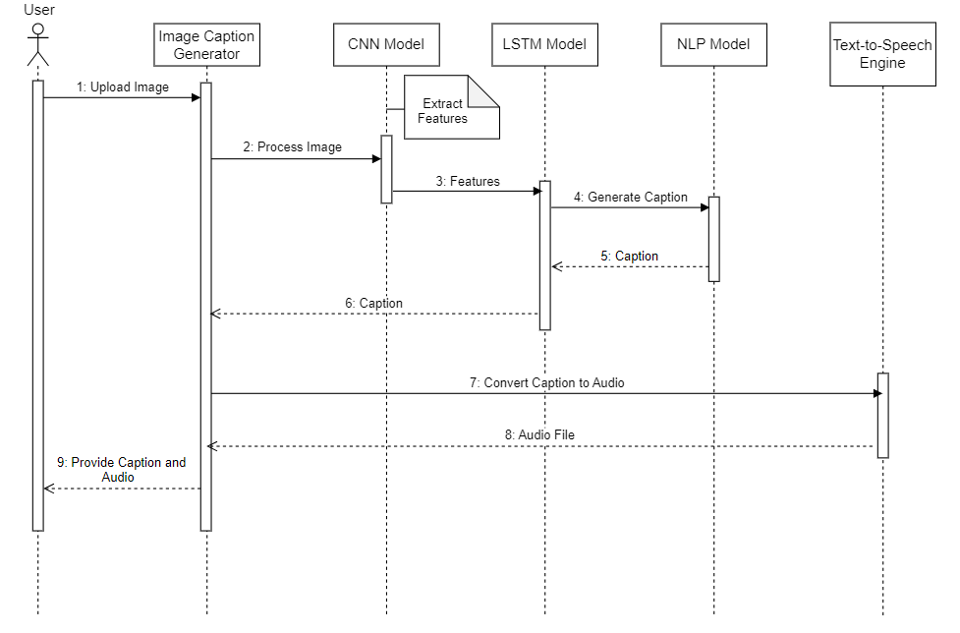
SEQUENCE DIAGRAM OF IMAGE CAPTION GENERATOR
The sequence diagram visually depicts the chronological flow of interactions, initiated by the "User" uploading an image. It illustrates the process, including image processing, caption generation, and the reading of the caption by the Text-to-Speech Engine.
Figure 9: Sequence Diagram of Image Caption Generator
15

Slide 16
MODULES
The modules used in this Image Caption generator are as follows:
string : To perform string operations on captions
numpy : To perform numerical operations
Pickle : To serialize and deserialize objects.
keras :To implement Neural networks.
PIL :Provides the interpreter with Image Editing Capabilities.
tensorflow: To create dataflow graph that describes how data moves through a graph.
matplotlib : For creating static and interactive visualizations.

Slide 17
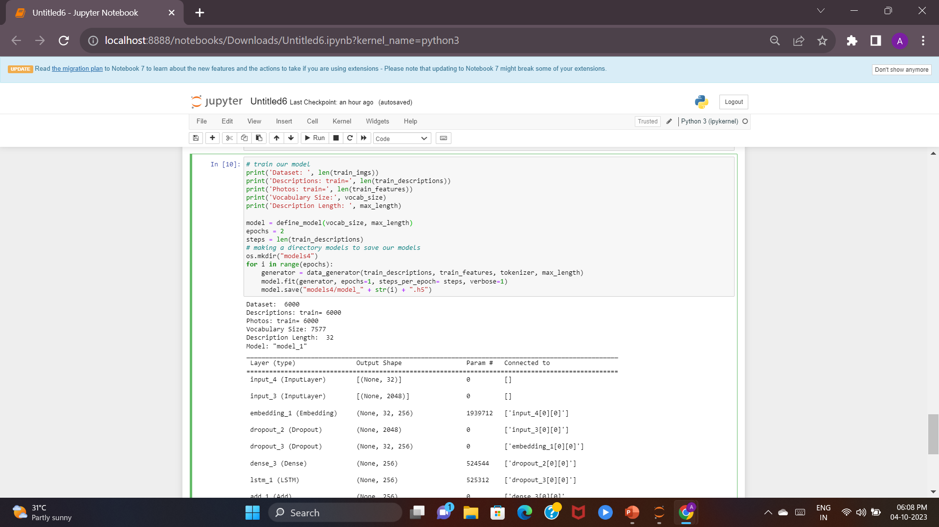
UNIT TESTING
Unit testing for a captioning model involves verifying its components, including image input processing, feature extraction, caption generation, and vocabulary handling.
It also tests loss functions, hyperparameter tuning, and low-level components such as RNN layers.
Edge cases are considered, and mock data or dependencies may be used for testing.
The goal is to ensure the model's internal logic and functionality are sound before integration into the broader system.
Figure 10: Performing Unit Testing

Slide 18
SYSTEM TESTING
System testing for an image caption generator project involves end-to-end evaluation, usability and performance checks, and ensuring security, compatibility, and scalability. It also includes user acceptance testing, accessibility validation, and adherence to regulations, while ensuring data integrity and error handling. The goal is to verify the system's functionality, usability, and reliability in a real-world context.
User acceptance testing is conducted to validate the system against user expectations, while regression testing ensures new changes don't introduce issues. Deployment and rollback procedures are also tested to ensure smooth updates and potential issue recovery.

Slide 19
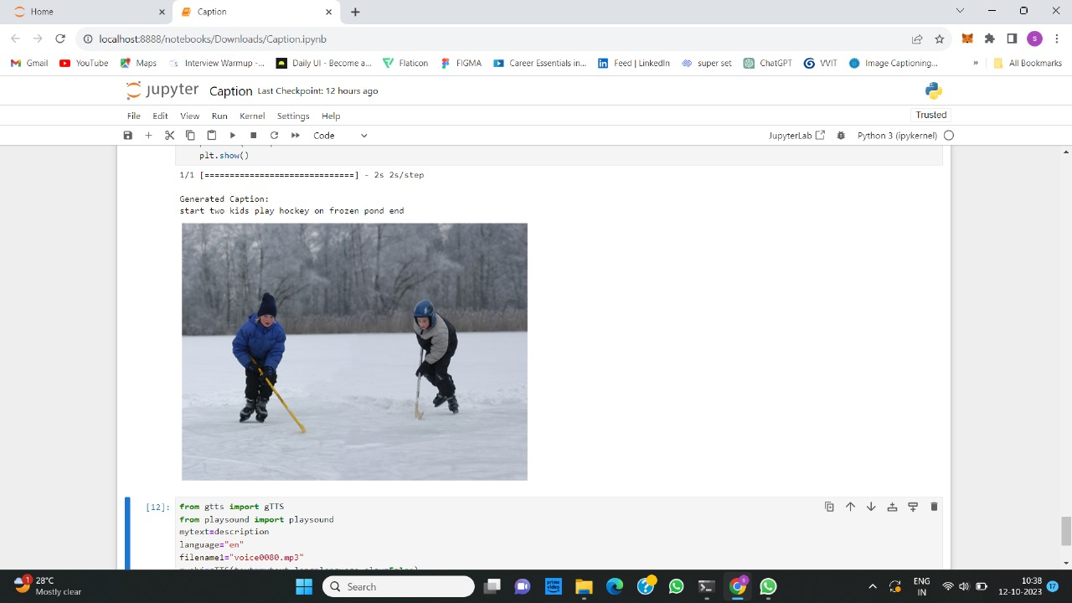
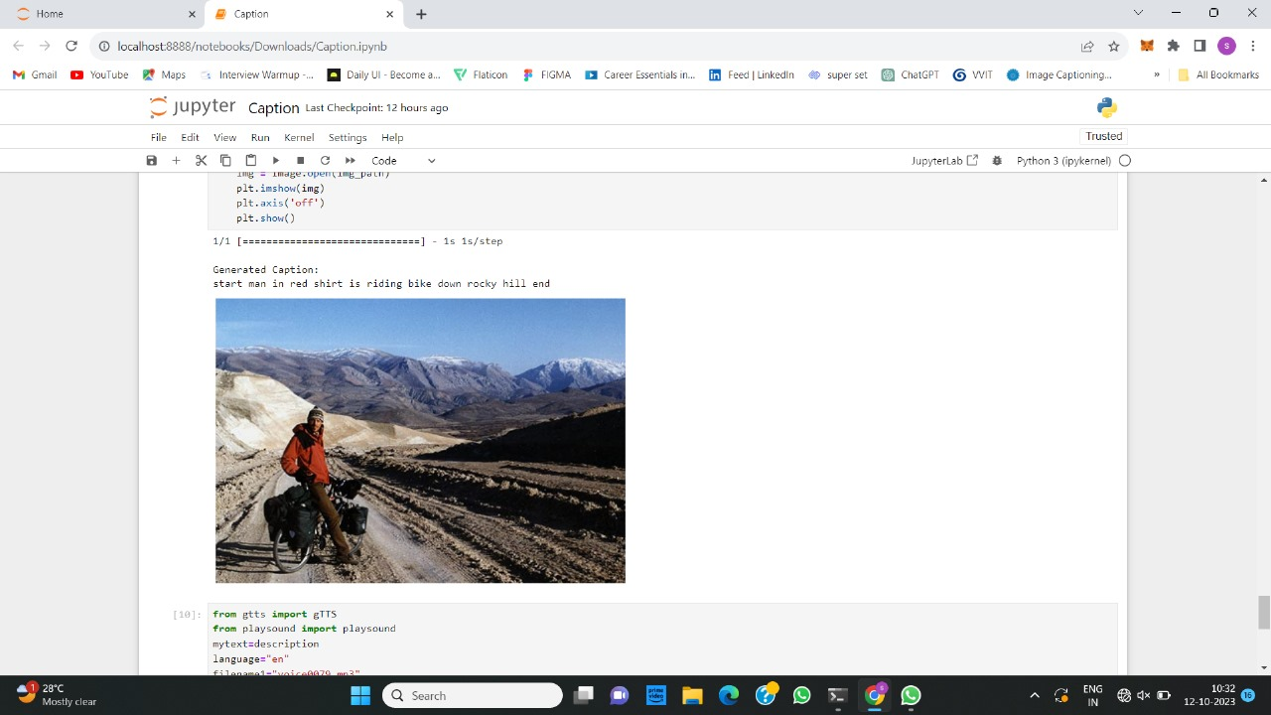

OUTPUT
Figure 11: Caption Generation
Caption for the uploaded image will be Generated as show in Figure 11.

Slide 20
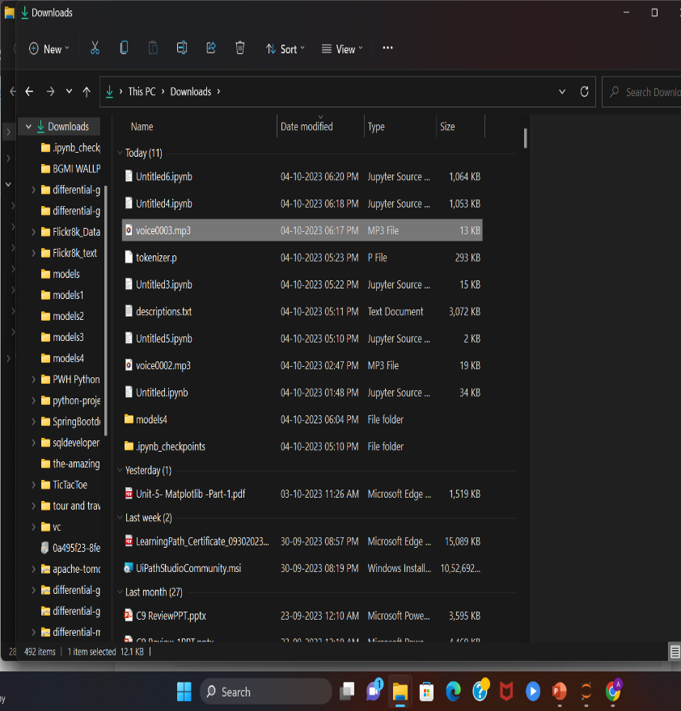
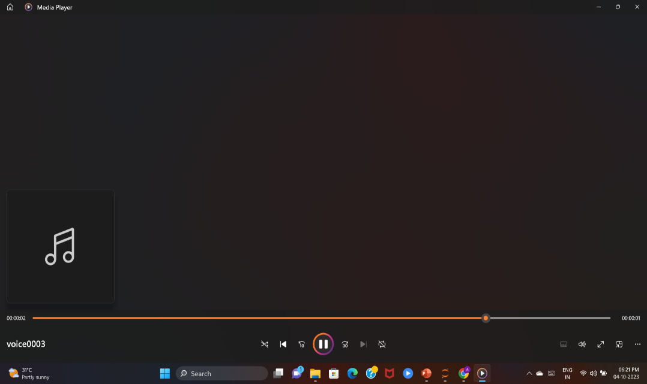
OUTPUT
Figure 12: Audio file of Generated Caption
Figure 13: Playing Audio
The audio file will be generated which contains the audio form of generated caption as show in Figure 12 & Figure 13.

Slide 21
CONCLUSION
In this project, We developed a Image Caption Generator System that uses CNN for image feature extraction and LSTM for natural language production has proven to be an effective method for creating image captions. This integration enables the model to comprehend an image's content and describe it in human-readable words.
By including speech synthesis into the Image Caption Generator, the user experience is enhanced by giving not just written but also auditory descriptions of images. This is especially useful for people who have visual impairments or in situations when reading text is impossible.
This technology has numerous potential uses, ranging from assisting the visually impaired in understanding their surroundings to assisting in content development and accessibility in domains such as education, healthcare, and entertainment.

Slide 22
FUTURE ENHANCEMENT
Adding multilingual support to the Image Caption Generator with speech synthesis would dramatically boost its global accessibility and usability.
It can be especially useful for applications such as international content generation, translation services, and multilingual accessibility in a variety of disciplines.
Extending and diversifying the training dataset can assist the model in becoming more adaptable and capable of dealing with a greater range of images and settings and also dealing with real-time live video captioning.

Slide 23
REFERENCES
[1] M. Pranay Kumar, V. Snigdha, R. Nandini and Dr. B. Indira Reddy, “Image Captioning Generator Using CNN and LSTM ”, Volume – 1Issue – VI (June 2022)(Available at www.ijraset.com) https://doi.org/10.22214/ijraset.2022.44502.
[2] Julu Basnet, Supriya Kumari, Mohit Rathore, Dipanshu, “Image caption generator using CNN and LSTM”, Volume - 8, Issue 2 - V8I2-1280 (Available online at: https://www.ijariit.com), 2022.
[3] Swarnim Tripathi , Ravi Sharma, “Image Caption Generator Using CNN 0, and LSTM”, Volume – 9, 2018, Available at http://www.ijert.org.
[4] Janvi Jambhale, Shreeya Sangale, Aarti Avhad, Payal Vairagade, Jameer Kotwal, “IMAGE CAPTION GENERATOR USING CONVOLUTIONAL NEURAL NETWORKS AND LONG SHORT-TERM MEMORY”, Volume – 04, Issue – 05th May-2022, Available at www.ijrmets.com.
[5] Parth Kotak, Prem Kotak, “Image Caption Generator”, Volume – 10, Issue - 11, November-2021, Available at http://www.ijert.org.

Slide 24
Thank You for your Attention…..
Any Queries?
24

